Slide 1


Vaishnavi Sanjay Lande.
Mental Health Prediction.

Slide 2
Mental Health Prediction.
Demo Link

Slide 3

AGENDA
Problem Statement.
Project Overview.
The wow in your solution.
Modelling.
Results.
Meet our team.

Slide 4

PROBLEM STATEMENT
Predicting Individual’s Mental Health using different Machine Learning Methods
Testing and comparing accuracies obtained from the implemented models
To develop a mental health prediction tool(Model)
Predicting whether a person is likely to be Mentally Ill or not.

Slide 5

PROJECT OVERVIEW
developed a different model which predicts the individual mental health
Used different algorithms for building the model and compare the accuracy of each model for identify the best

Slide 6

THE WOW IN YOUR SOLUTION
The wow in solution is that it has good system stability and can meet the actual current situation .which are requirements for evaluating the unemployed individual mental health .and the model predicts the result near to actual values.

Slide 7
MODELLING
Dataset: I use data from the Unemployment and Mental Illness Survey, which is accessible on Kaggle, to demonstrate a novel method for detecting mental illness. The data contains 31 features, including information about the person's gender, clinical conditions like anxiety, mental illness history like "I have previously been hospitalized for my mental illness," employment/income circumstances like "I am unemployed," and technological familiarity like "I have regular access to the internet.". The dataset contains 334 instances.
Various machine learning classification models are trained using this dataset. Support Vector Machine, Logistic Regression, and Random Forest Classifier, all used in this project .
Feature Extraction: Random Forest Classifier was used to select the most important features.
Metrics used for comparison:
○ F1-Score
○ Accuracy

Slide 8
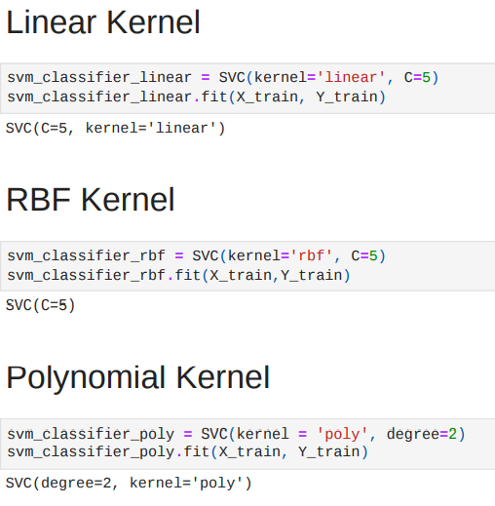
MODELLING
Models
1. SVM: The Support Vector Machine, or SVM, is a popular Supervised Learning technique that may be used to solve both classification and regression problems.
Model Building:

Slide 9
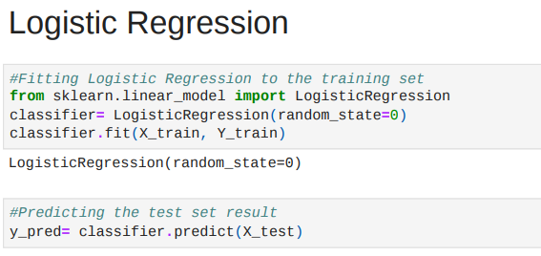
MODELLING
2.Logistic Regression: Logistic Regression is a Supervised Learning technique, which is used to predict a categorical dependent variable using a set of independent factors. As a result, the result must be a discrete or categorical value.
Model Building:

Slide 10
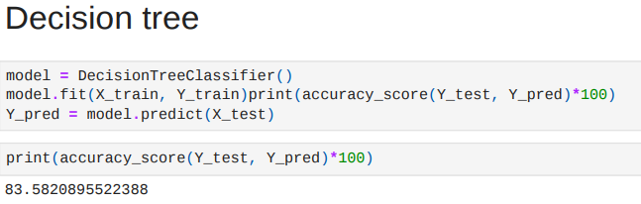
MODELLING
3. Decision Tree: A decision Tree is a supervised learning technique that may be used to solve both classification and regression problems, however, it is most commonly employed to solve classification issues
It is called a decision tree because, similar to a tree, it starts with the root node, which expands on further branches and constructs a tree-like structure.
Model Building:
.

Slide 11
RESULTS
To evaluate the model’s performances on the validation dataset, I used F1-score and Accuracy metrics.
SVM (linear kernel) performs evaluation score with 88% accuracy
SVM (RBF) performs evaluation score with 87% accuracy
SVM (polynomial kernel)perform evaluation score with 88% accuracy
Logistic Regression performs evaluation score with 96% accuracy
Decision Tree performs evaluation score with 84% accuracy
From the above experiments and results, we can see that the Logistic Regression yield the best F1 score and accuracy

Slide 12
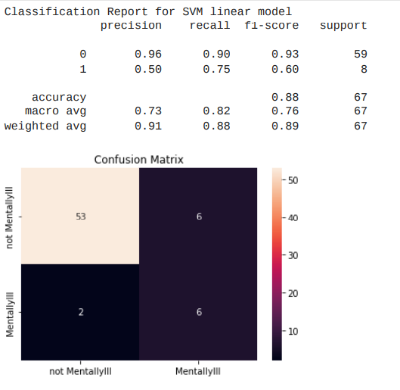
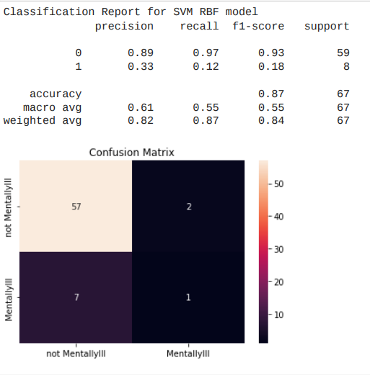
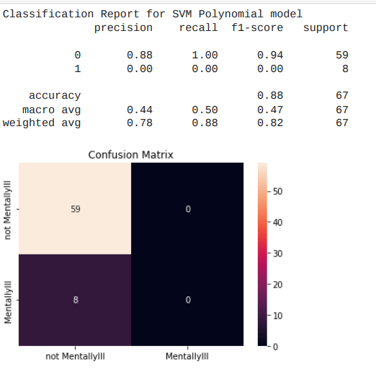
RESULTS
Result of SVM
SVM Linear Model: 2) SVM RBF Model: 3)SVM Polynomial Model:

Slide 13
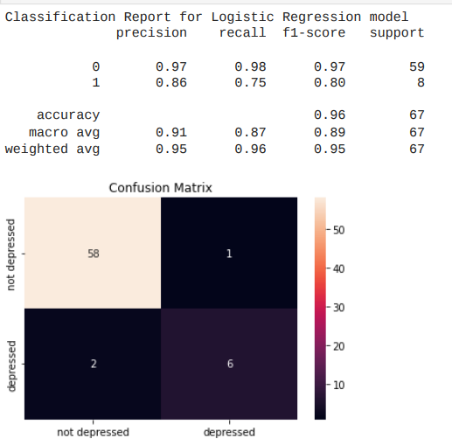
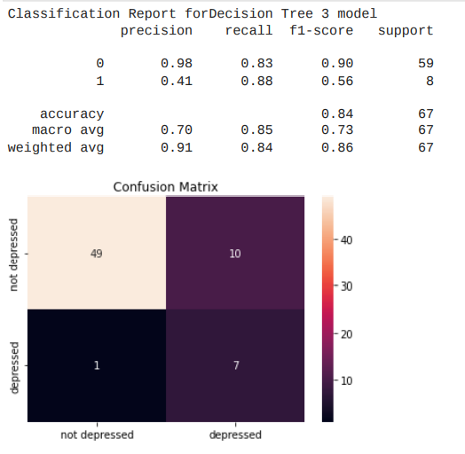
RESULTS
Result of Logistic Regression : Result of Decision Tree:

Slide 14

MEET OUR TEAM
Vaishnavi Sanjay Lande.
Department of Information Technology,
Shri Sant Gajanan Maharaj College of Engineering, Shegaon. SGBAU, India.
landevaishnavi04@gmail.com
.
.

